Slide 1
Domain adaptation
李金凤
2019/5/31

Slide 2
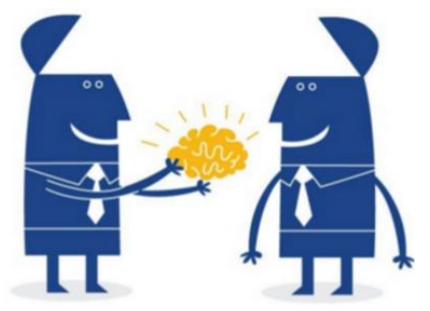
Background:
Traditional machine learning: training data and test data are drawn from the same feature space and the same distribution.
Distribution change.
It is expensive or impossible to re-collect the needed training data and rebuild the models.
In such cased, domain adaptation is extensively studied to bridge different but related domains.

Slide 3
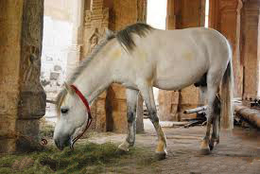
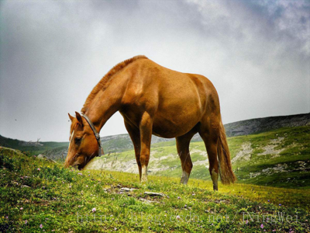
Goal: narrow down the distribution gap between source and target data, such that the labeled source data from one or more relevant domains can be utilized for executing tasks in target domain.
Source domain
target domain
Distribution match
Transfer model

Slide 4
Related works:
Instance reweighting adaptation
shallow regime
Domain adaptation
Feature adaptation
Deep network adaptation
Deep regime
Adversarial adaptation

Slide 5
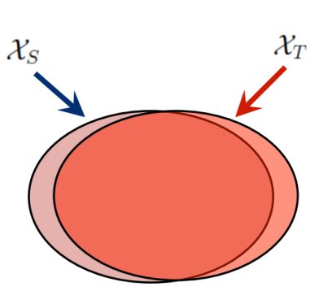
shallow regime
Instance reweighting adaptation:
1. The difference between the source domain and
the target domain is not too large.
2. The objective is to reweight the source data
so that the distribution across domains can be
more closed.
3. “TrAdaBoost” [1]
Hypothesis: certain parts of source data can still be reused.
Method: find out which those data are by employing a small amount of labeled target data.

Slide 6
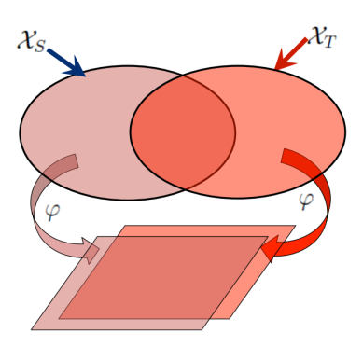
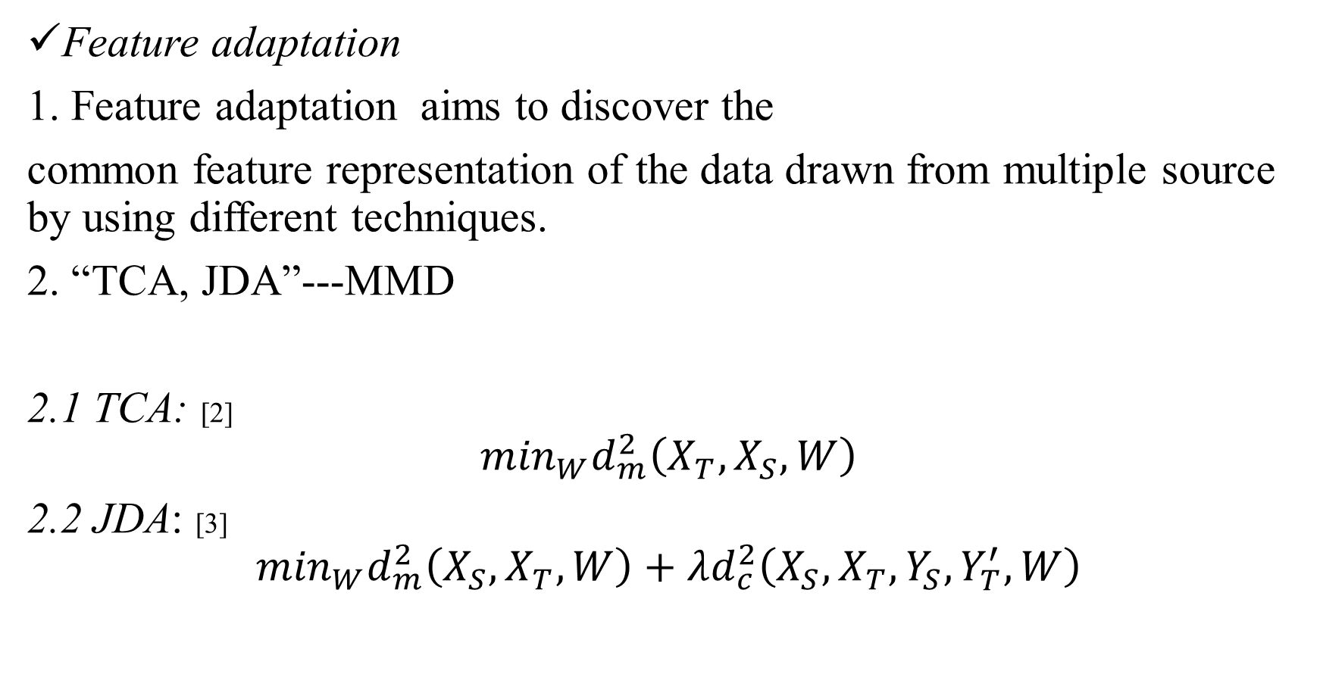
Feature adaptation
1. Feature adaptation aims to discover the
common feature representation of the data drawn from multiple source by using different techniques.
2. “TCA, JDA”---MMD
2.1 TCA: [2]
$$\min_{W}d_{m}^{2}\left(X_{T},X_{S},W\right)$$
2.2 JDA: [3]
$$\min_{W}d_{m}^{2}\left(X_{S},X_{T},W\right)+λd_{c}^{2}\left(X_{S},X_{T},Y_{S},Y_{T}^{′},W\right)$$

Slide 7
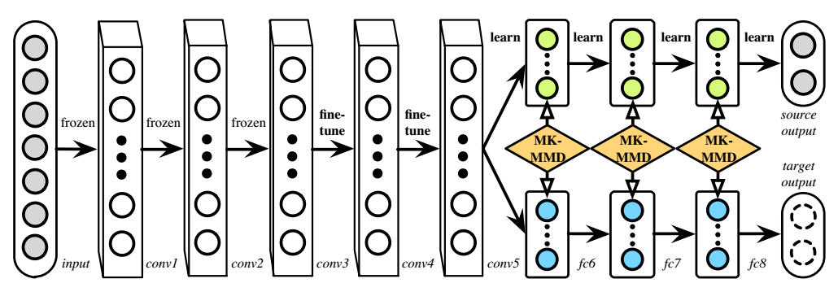

Deep regime
Deep network adaptation
1. Yosinski: Transferability of feature in bottom, middle and top layers of DNN, and demonstrated that the transferability of features decrease as the distance between domains increase [4].
2. DAN: [5]
The basic idea of DAN is to enhance feature transferability in task-specific layers of DNNs.
$$\min_{θ}\frac{1}{n_{s}}\sum_{i=1}^{n_{s}}{J\left(θ\left(x_{i}\right),y_{i}\right)+λ\sum_{l}{d_{m}^{2}\left(D_{S}^{l}, D_{T}^{l}\right)}}$$

Slide 8
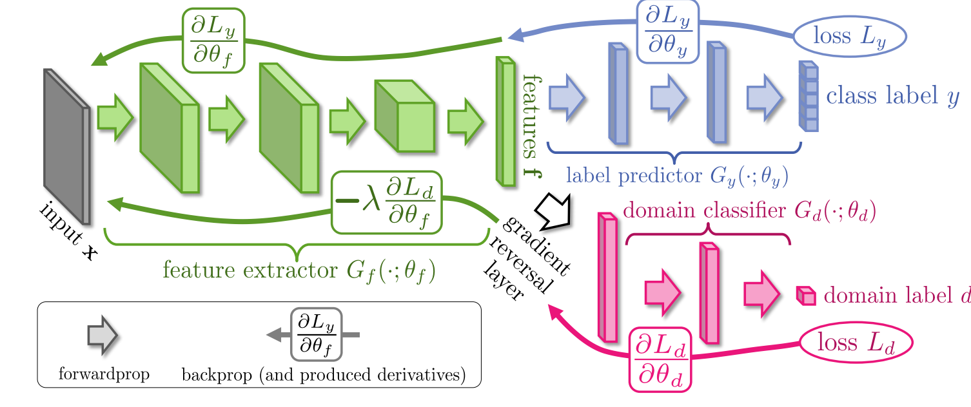
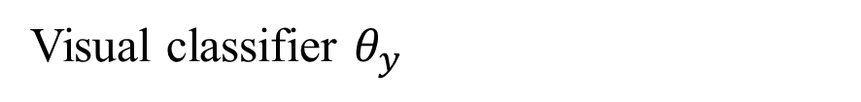
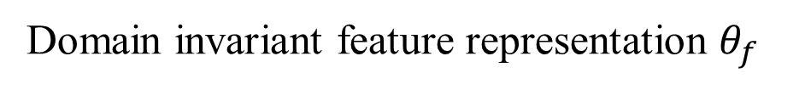
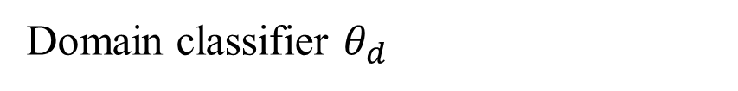
Adversarial adaptation
1. Minimization of the domain disparity is amount to domain confusion in a learnt feature space, where the domain discriminator cannot discriminate which domain a sample comes from.
2.“GRL” [6], “ADDA” [7]:
2.1 “GRL”—gradient reversal layers
Domain invariant feature representation $θ_{f}$
Visual classifier $θ_{y}$
Domain classifier $θ_{d}$

Slide 9
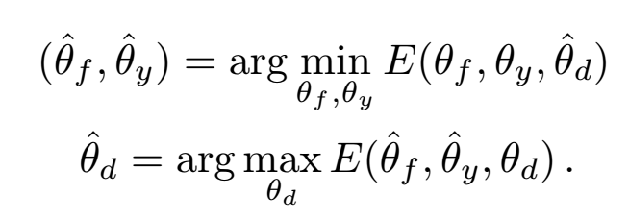

$θ_{f}$ can be learnt by trying to minimize the visual classifier loss $L_{y}$ and simultaneously maximize the domain classifier loss $L_{d}$.
The contribution gradient from loss $L_{y}$ and $L_{d}$ are $\frac{∂L_{y}}{∂θ_{f}}$ and $−λ\frac{∂L_{d}}{∂θ_{f}}$.

Slide 10
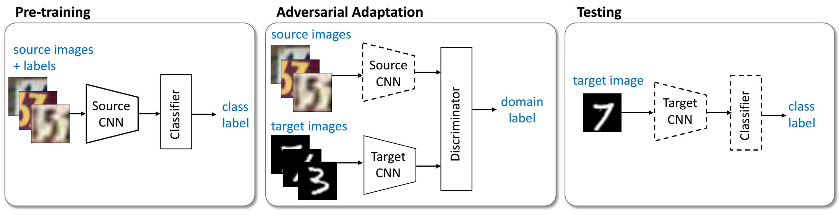

2.2 ADDA
Two CNNs are separately learnt for source and target domains, the training of source CNN relies only on the source data by minimizing the loss $L_{C}$ while the target CNN and the domain discriminator loss $L_{D}$ are alternatively trained in an adversarial fashion with the source CNN fixed.

Slide 11
Reference:
[1] W. Dai, Q. Yang, G.R. Xue and Y. Yu, “Boosting for transfer learning,” in ICML, 2007, PP. 193-200.
[2] S. J. Pan, I. W. Tsang, J.T. K wok and Q. Yang, “Domain adaptation via transfer component analysis,” IEEE Trans. Neural Networks, vol. 22, no. 2, pp. 199-210.
[3] M. Long, J. Wang, G. Ding, J. Sun and P. S. Yu, “Transfer feature learning with joint distribution adaptation,” in ICCV, 2014, pp.2200-2207.
[4] J. Yosinski, J. Cune, Y. Bengio and H. Lipson, “How transferable are features in deep neural networks,” in NIPS, 2014.
[5] M. Long, Y. Cao, J. Wang and M. I. Jordan, “Learning transferable features with deep adaptation networks,” in ICML, 2015, pp. 97-105.
[6] Y. Ganin and V.Lempitsky, “Unsupervised domain adaptation by backpropagation, ” in arXiv, 2015.
[7] E. Tzeng, J. Hoffman, K. Saenko and T. Darrell, “Adversarial discriminative domain adaptation,” in CVPR, 2017, PP. 7167-7176.

Slide 12
Thank you

Slide 13
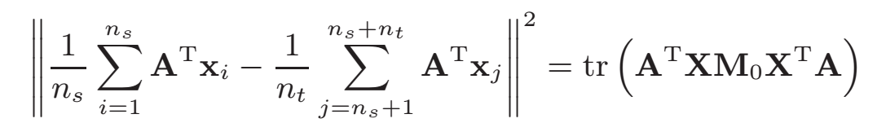
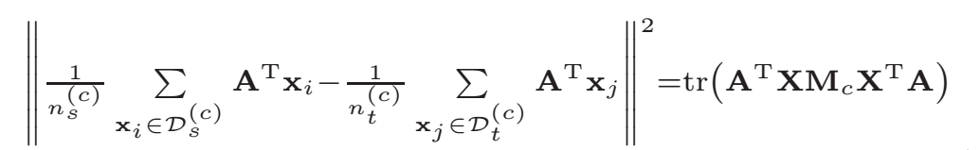
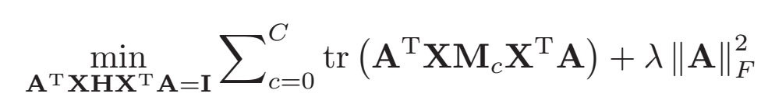
Supplements:
JDA:

Slide 14
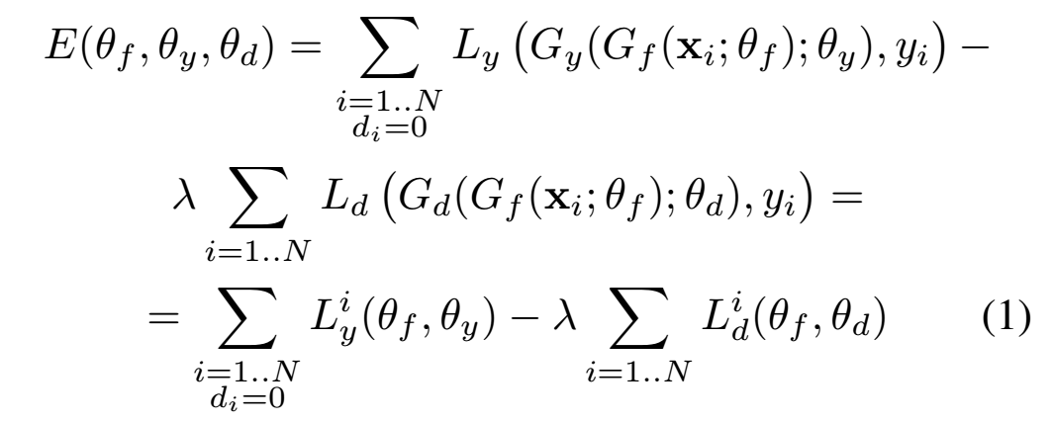
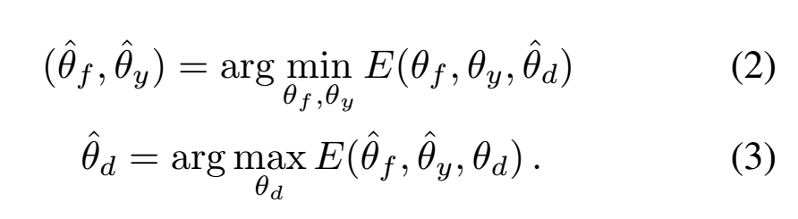
GRL:

Slide 15
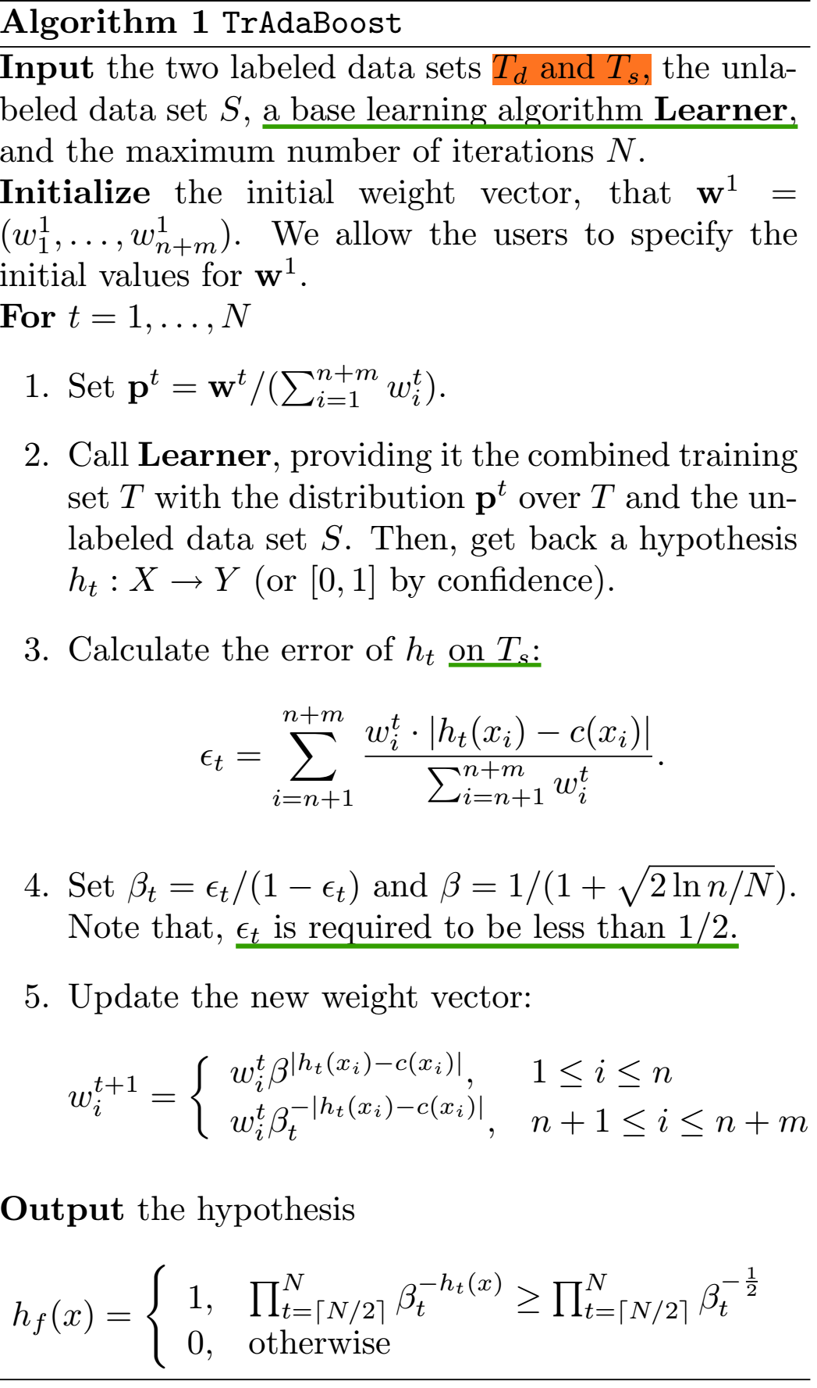
TrAdaBoost:

